Slide 1

Banking Risk Analytics Dashboard
Project Report: Enhancing Credit Risk Visibility

Slide 2

The Challenge: Mitigating Lending Risk
Banks face significant financial and regulatory risks from customer loan defaults, leading to high non-performing assets and capital erosion. Our project aims to empower decision-makers with data-driven insights.
Identify High-Risk Clients
Monitor Imbalance
Track loan-to-deposit ratios and exposure concentration.
Pinpoint vulnerable clients and segments.
Support Decisions
Enable data-driven credit and portfolio choices.

Slide 3

Data Foundation: Comprehensive Banking Insights
Our analysis leverages historical banking data to build a robust risk assessment model.
Client Demographics
Gender, nationality, income band.
Banking Relationships
Retail, Private Bank, Commercial, Institutional.
Loan Details
Amount, business lending, credit card balances.
Deposit Details
Savings, checking, foreign currency, total deposits.
Risk Indicators
Risk Score: High / Medium / Low.
Engagement Tenure
Years with the bank.

Slide 4

Exploratory Data Analysis (EDA)
Using Python, we cleaned and analyzed data to uncover critical patterns.
01
Data Cleaning
Missing values and data type corrections.
02
Derived Metrics
Loan-to-Deposit Ratio, Client Count.
03
Distribution Analysis
Loan amounts, deposits, risk categories.
04
Outlier Identification
Skewness in loan exposure.
Key EDA Findings:
Loan and deposit values are right-skewed, indicating concentration among fewer high-value clients.
High-risk clients show higher loan exposure relative to deposits.
Longer engagement does not always imply lower risk.

Slide 5
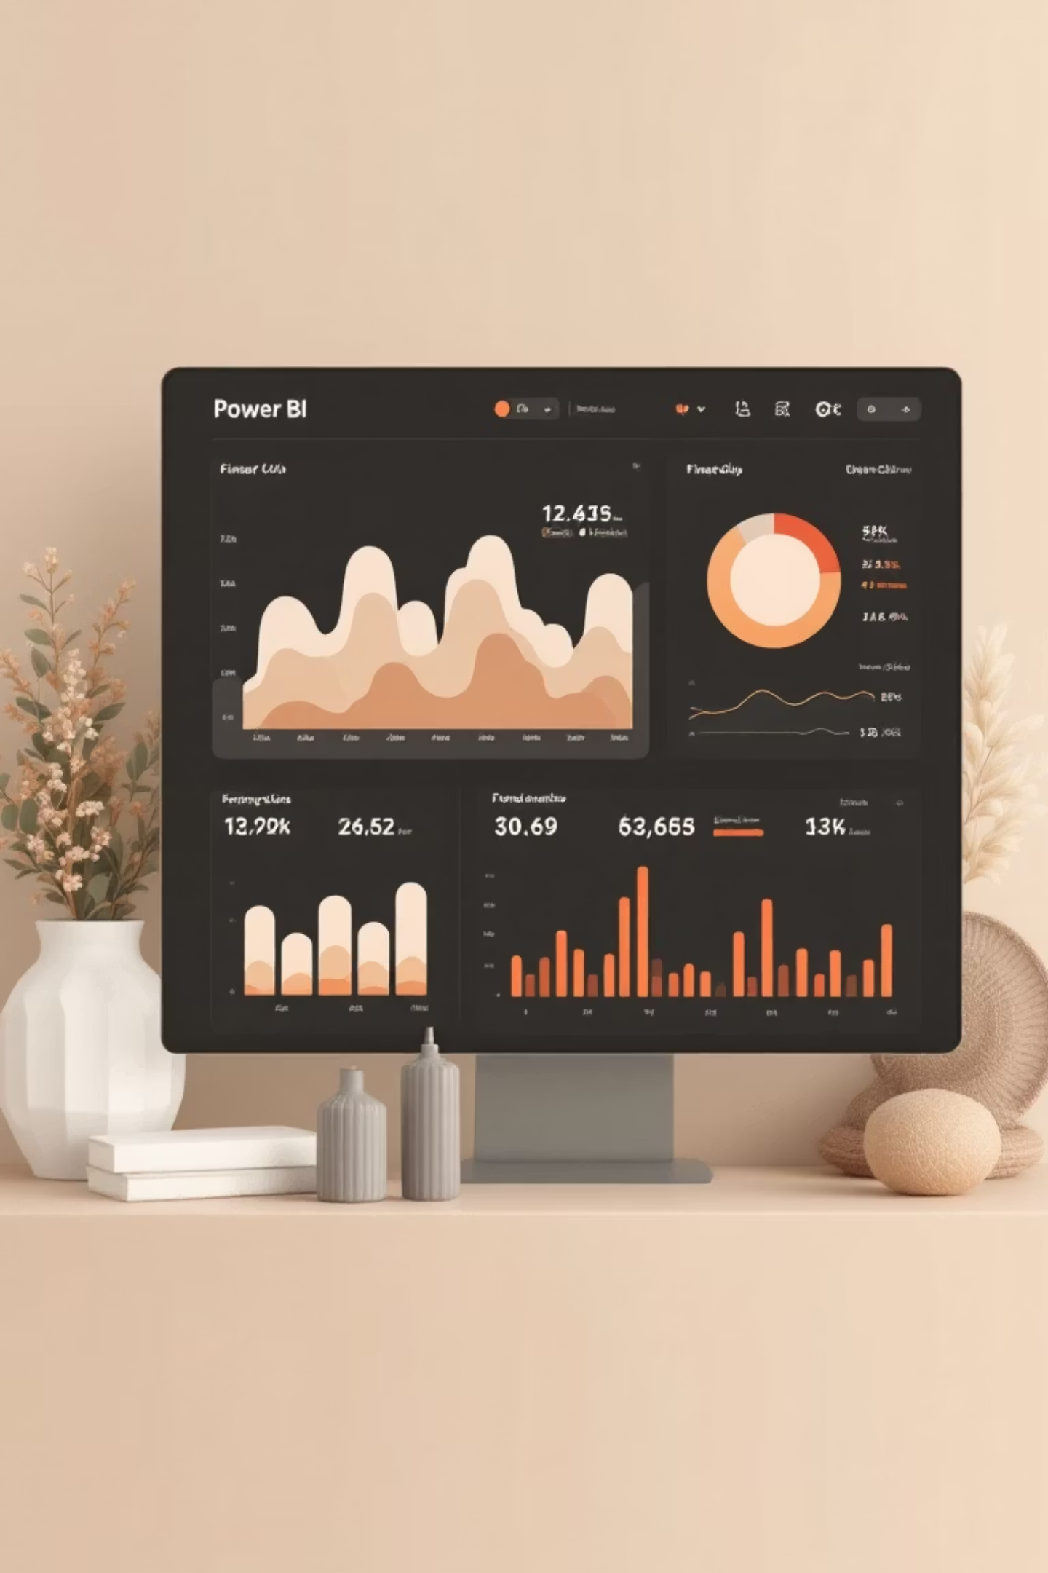




Dashboard Structure: Power BI
Our Power BI dashboard is organized into four intuitive pages, each addressing specific business questions for comprehensive risk management.
Executive Summary
High-level portfolio health.
Loan Analysis
Exposure and concentration.
Deposit Analysis
Funding stability and liquidity.
Summary & Segmentation
Risk, exposure, and actionability.

Slide 6


Executive Summary & Loan Analysis
Executive Summary
Loan Analysis
A snapshot of portfolio health.
Understanding loan exposure and concentration.
3000
32.8%
Total Loan: ₹4.38bn.
Business Lending dominates total exposure (₹2.6bn).
Total Clients
High Risk %
Private Banking contributes disproportionately to high-risk loan exposure.
₹4.38bn
116%
Total Loan Portfolio
LDR

Slide 7
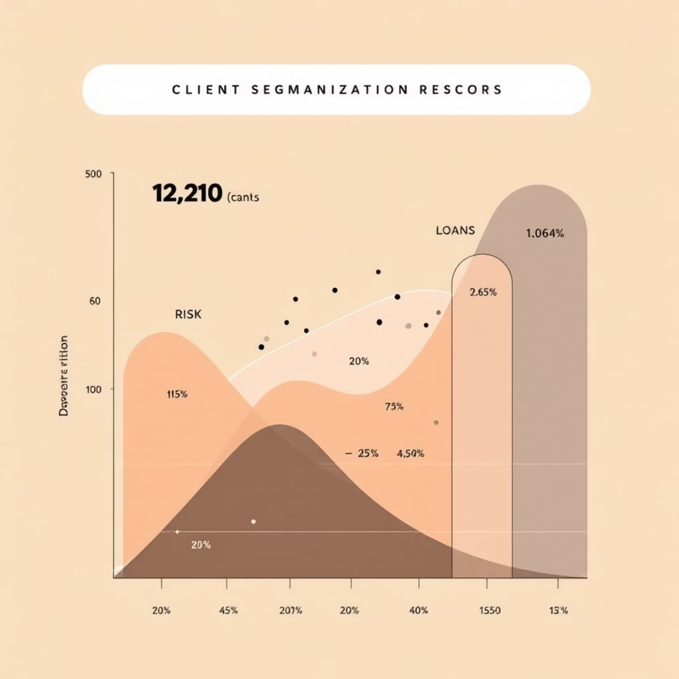

Deposit Analysis & Risk Segmentation
Deposit Analysis
Summary & Risk Segmentation
Evaluating funding stability and liquidity support.
Combining risk, exposure, and actionability.
Total Deposits: ₹3.77bn.
High-risk clients cluster in high-loan / low-deposit quadrant, while low-risk clients show stronger deposit backing.
Checking and Savings accounts form the bulk of deposits.
European clients contribute higher deposits with lower risk.

Slide 8


Key Insights: Unveiling Critical Trends
Liquidity Risk
LDR at 116% indicates overleveraging; loans exceed deposit base.
Risk Concentration
32.8% of clients (984) are High Risk, totaling ₹1.78bn exposure.
Segment-Level Insights
Private Banking and European clients offer growth opportunities due to lower risk profiles.
Engagement Tenure
Clients with <10 years engagement carry higher risk-weighted loan exposure.

Slide 9

Actionable Recommendations
Strategic steps to mitigate risk and capitalize on growth opportunities.
Immediate Actions
1
Reduce loan growth until LDR < 100%.
Increase deposit mobilization campaigns.
Risk Mitigation
2
Tighten credit approval for High Risk segments.
Introduce stricter collateral and pricing.
Growth Opportunities
3
Expand lending cautiously within Private Banking.
Target European and Low Risk clients.
Monitoring & Governance
4
Track High Risk % monthly.
Set early-warning triggers for LDR breaches.

Slide 10

Conclusion: Empowering Data-Driven Decisions
This project provides a powerful solution for proactive credit risk management, balancing growth with liquidity stability.
Enhanced Visibility
Tools & Technologies:
Combining EDA, KPIs, and interactive dashboards.
Python: Pandas, NumPy, Matplotlib, Seaborn.
Power BI: DAX measures, conditional formatting, drill-through.
Proactive Management
SQL (optional): Data validation and aggregation.
Reduce default probability and manage exposure.
Actionable Insights
Support executive decision-making and risk teams.

